Slide 1
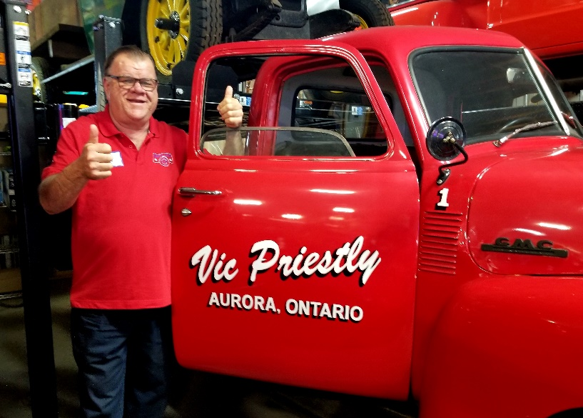
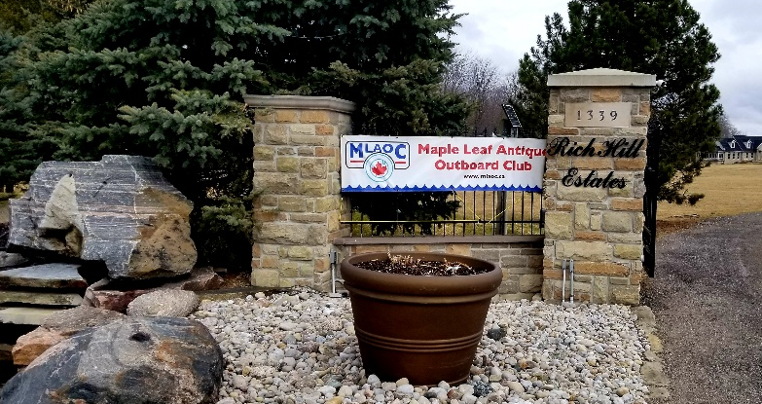
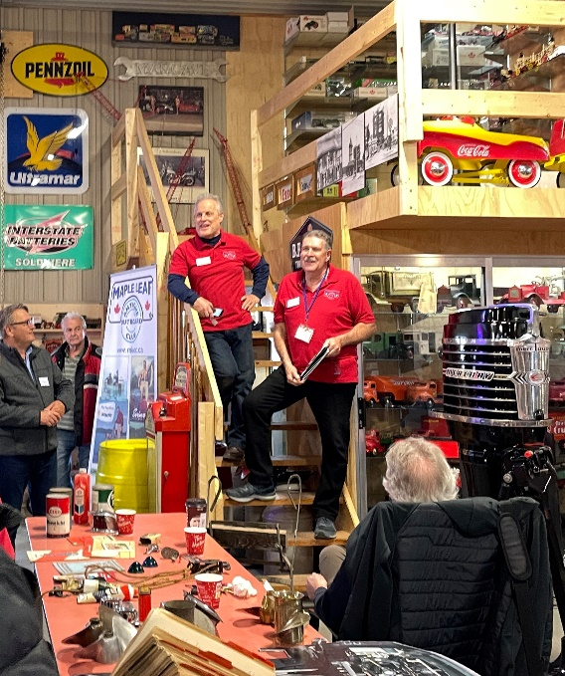
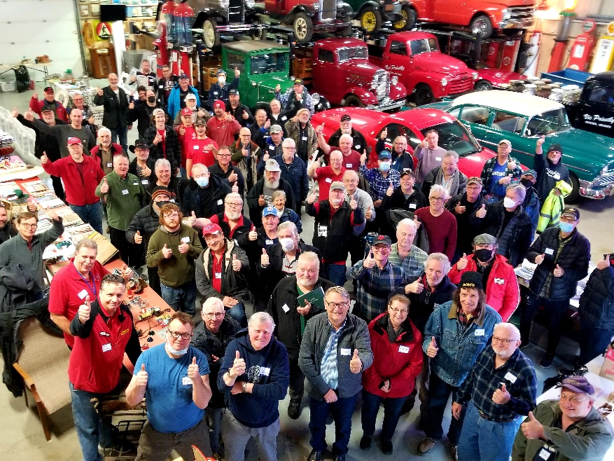
MLAOC Hard Water Meet – Mar. 26
Report: Ken Kirk Photos: Sandy Kennedy & Ken Kirk
It was a great day, a spectacular location and a large turn out for our HARD WATER MEET, March 26. More than eighty MLAOC Members and friends turned out to reconnect face to face with fellow collectors. New members had an opportunity to get some of their technical questions answered or find out who could help them with parts or assistance.
The swap meet was extremely active with ten vendors set up for action. A wide range of quality items were offered for sale. There were outboards and parts, sales & service literature, advertising, boating accessories and hardware, toy boats and outboards, trophies, gas & oil collectables and much more.
Some members brought motors to display. Bruce Reinhardt showed his beautifully restored 1950’s
J Class Champion Hot Rod race motor. Matt Lockett presented a spectacular Merc 1000 “Tower of Power” which he had recently restored. It went home in Sandy Kennedy’s van. Bruce Goss brought three unique restored small displacement single cylinder air cooled marine motors. They were inboards, not outboards, but we let him stay anyway.
Our host was MLAOC member Vic Priestly who generously opened up four buildings which house his various, well curated, collections.
Our host Vic Priestly with a warm welcome for all.
Cont’d pg. 5
Event organizer Sandy Kennedy
& President Ron Stevenson updating
Members on 2022 events.
Some of the more than eighty energized
MLAOC Members in attendance.
Page 4

Slide 2
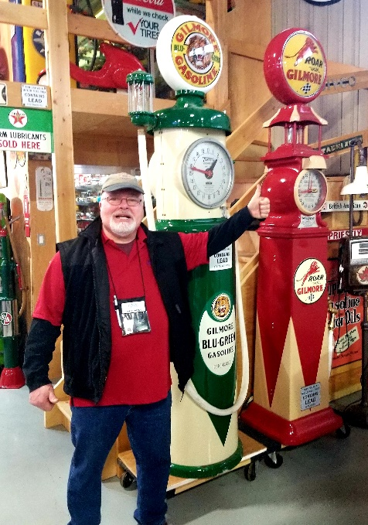
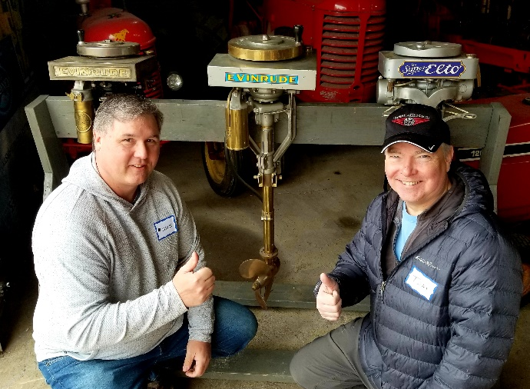
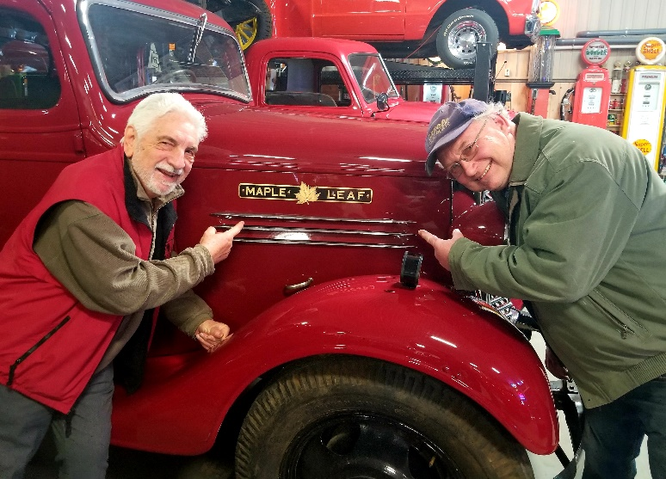
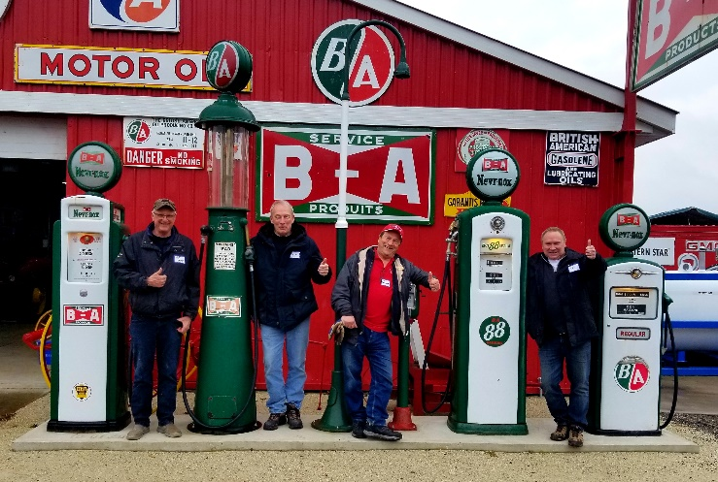
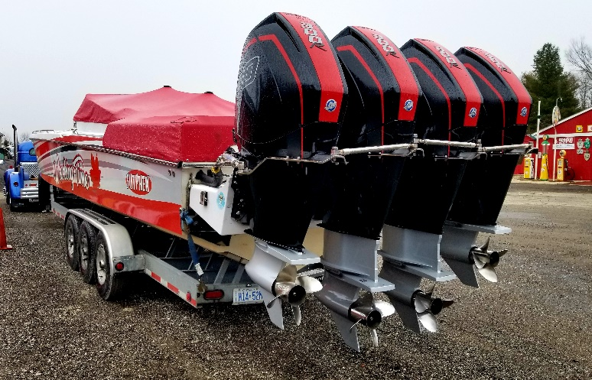
MLAOC Hard Water Meet
Cont’d
The scope of Vic’s collecting, beyond outboards, includes antique and classic cars and trucks, tractors, toy trucks and peddle cars. Vic is also an avid collector of gas and oil items from pumps and advertising to oil cans and containers. If you weren’t there you missed a great opportunity to see an incredible collection.
MLAOC President, Ron Stevenson, took the opportunity to identify the various MLAOC Events that were being planned for 2022, (an updated Event Schedule is on pages 12, 13 & 14 of this Newsletter and will also be posted on our mlaoc.ca website). President Ron also thanked Sandy Kennedy for organizing this great event. Much appreciated Sandy, well done.
Sandy Kennedy in turn expressed MLAOCs appreciation and thanks to Vic Priestly for generously opening up his buildings and collections too our members for viewing. Sandy also recognized Mike Kreckel and Scott Waites for their help with set up and organizing coffee, sweet treats and the pizza lunch. Not a crumb or crust was left. There sure was a lot of enthusiasm and energy in the air. What a kickoff to, what promises to be, an exciting year for antique and classic outboarding. Keep your spark plugs dry and keep on having fun.
Glenn Weigel hitchhiking home.
Cont’d pg. 6
Mike & Tom approving of Vic’s
Evinrude Rowboat Motors & Elto Ruddertwin.
Ken Kirk & Murray Parnell. We didn’t know MLAOC had our own truck.
Four MLAOC Members recalling their youth & summer jobs pumping gas.
Vic Priestly’s 39’ Sutphen Poker Run Race Boat with 4 MERC 300-R Outboards.
Page 5

Slide 3
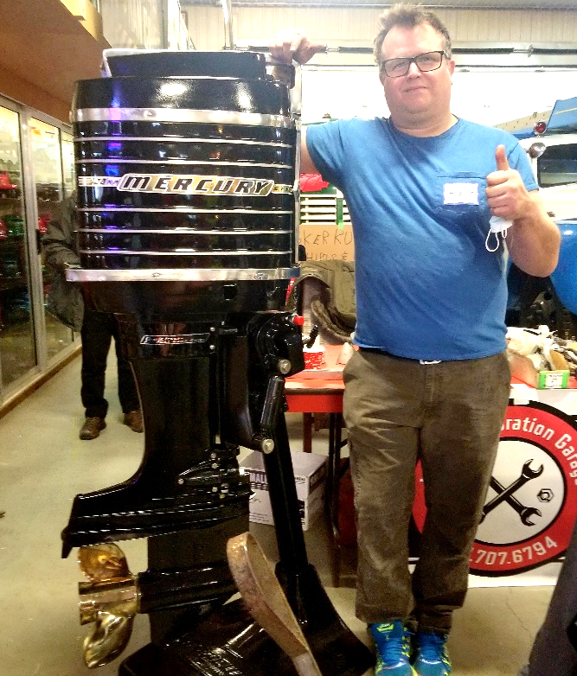
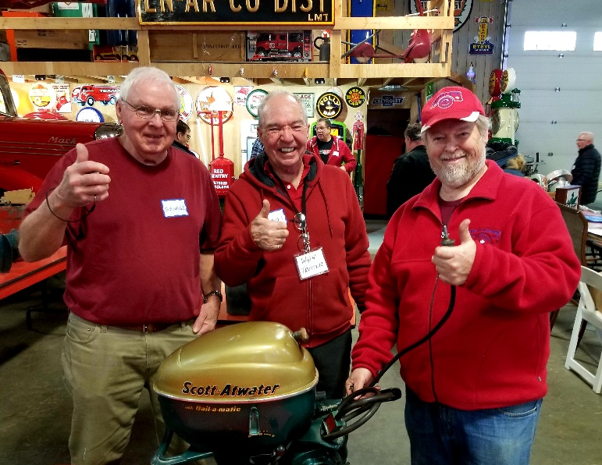
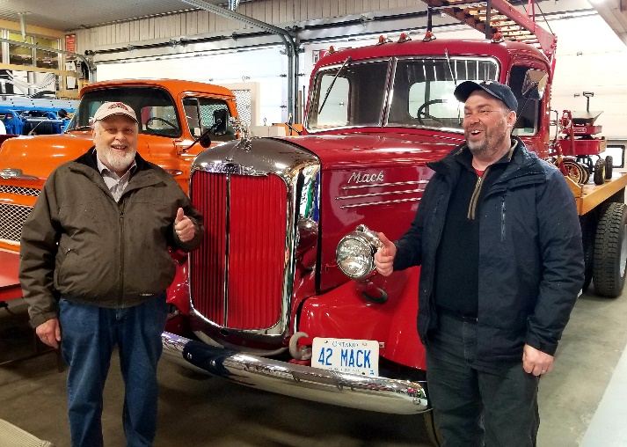
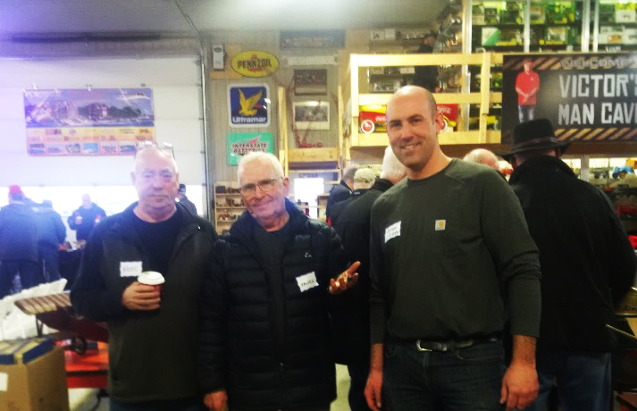
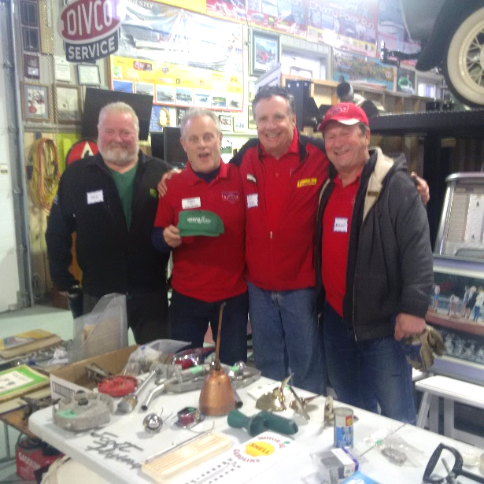
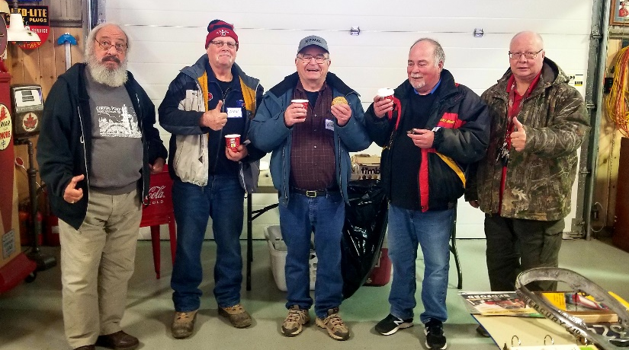
MLAOC Hard Water Meet
Cont’d
L to R: George Publow, Wain Trotter & Mike Kreckel.
Matt Lockett with MERC 1000 “Tower of Power” he has recently restored.
Bruce & Blair Goss with a 1942 Mack Truck.
L to R: Ross & James with Adam Gibb.
L to R: Ted Moss, Sandy Kennedy,
Scott Waites & August Sapinet
Early arrivers enthusiastically dig into the Coffee & Timbits.
Page 6

